Slide 1

FUTURE SKILLS
International Educational Programme
SPACE SYSTEMS ENGINEERING
Day 1: 4th October 2022
Mamudu Hamidu
Ghana

Slide 2
Sputnik and the Dawn of the Space Age
History changed on October 4, 1957, when the Soviet Union successfully launched Sputnik I.
The world's first artificial satellite was about the size of a beach ball (58 cm.or 22.8 inches in diameter), weighed only 83.6 kg. or 183.9 pounds, and took about 98 minutes to orbit Earth on its elliptical path.
That launch ushered in new political, military, technological, and scientific developments.
While the Sputnik launch was a single event, it marked the start of the space age and the U.S.-U.S.S.R space race.

Slide 3
Each year, the first week of October kicks off the United Nation's World Space Week, which celebrates the world's achievements in space since the dawn of the Space Age

Slide 4
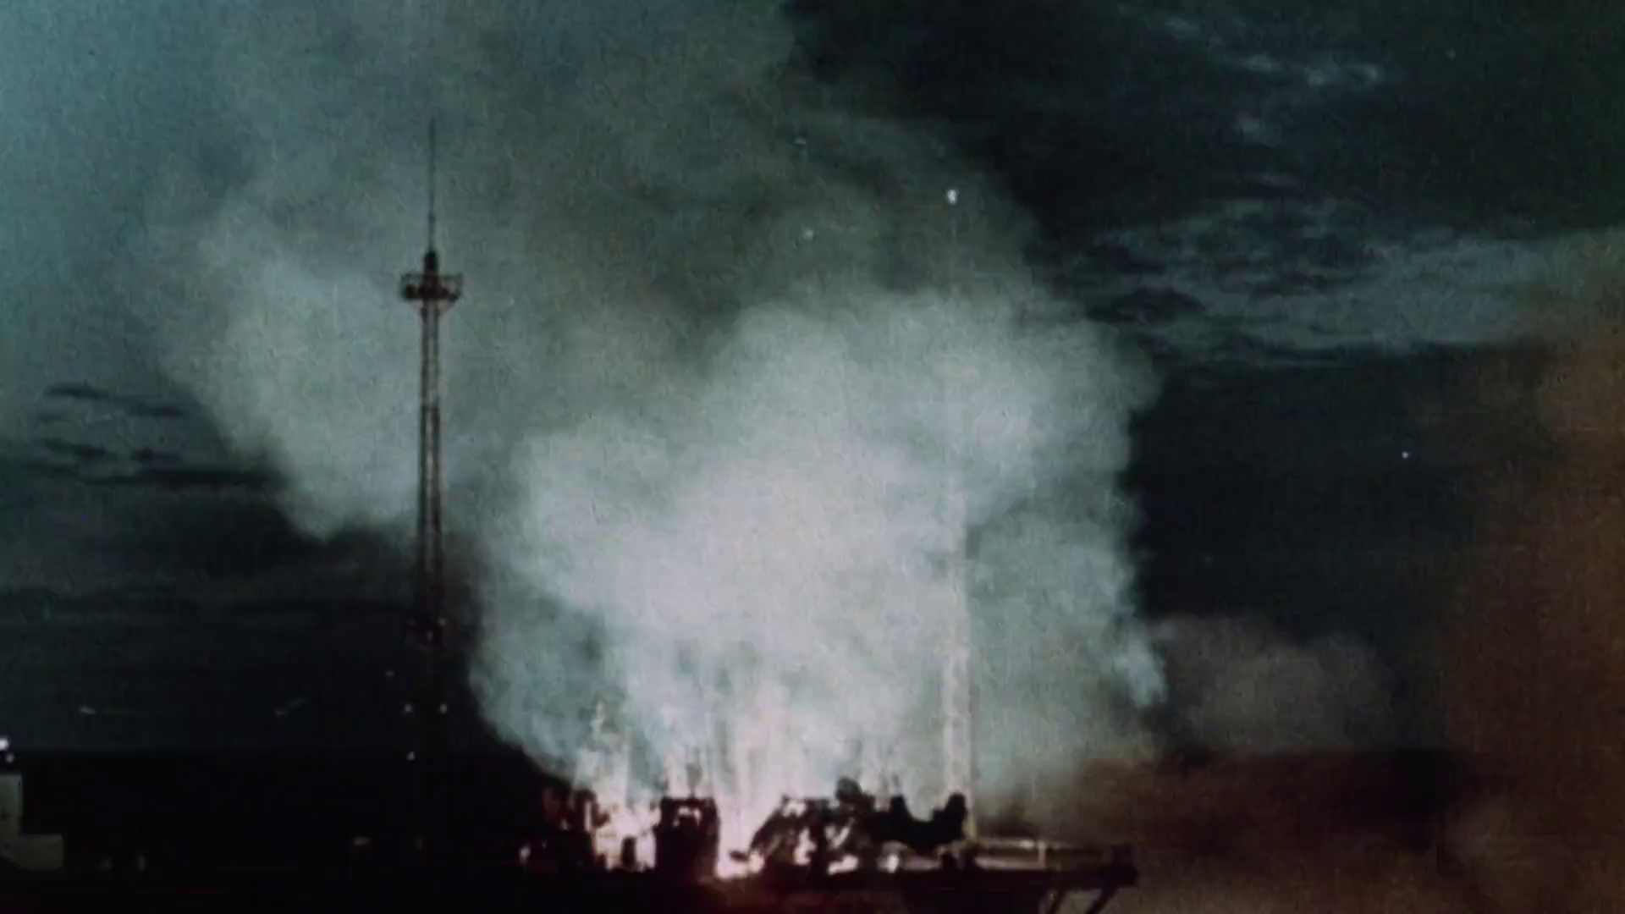

Slide 5
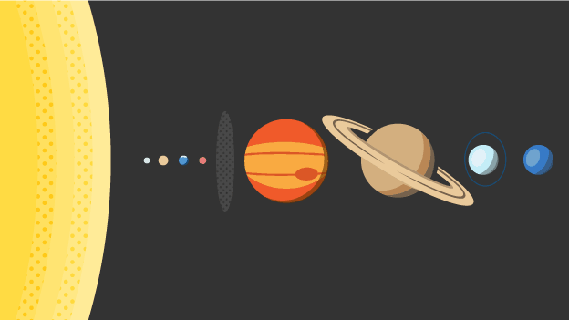

Slide 6
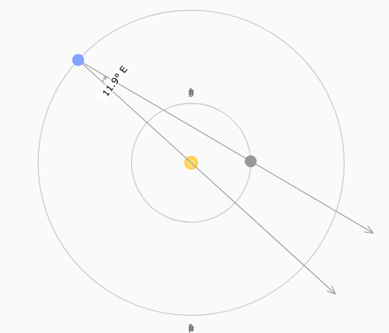
Configurations Simulator
Planetary Configurations Simulator
configurationssimulator.rar
Models the movements of the planets around the sun in a simplified Copernican model of the solar system.

Slide 7
Content
Introduction (0.5 hours)
Today’s class: Module 1 (2.5 hours)
History about Programme
Objectives of the Programme
Modules in the programme

Slide 8
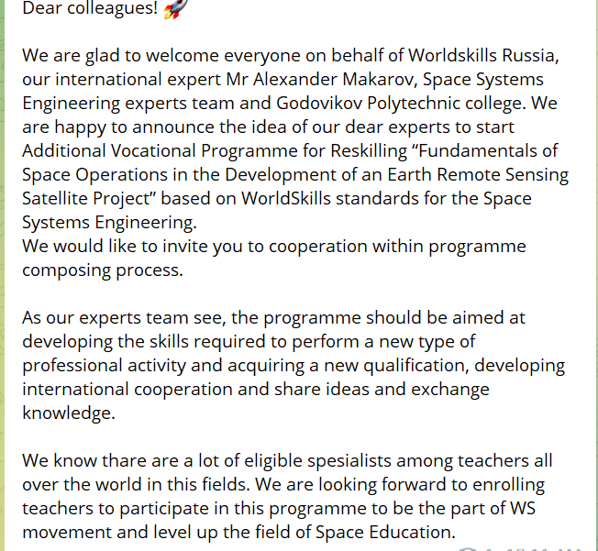
History about Programme and collaboration
in 2021
Alexader and team
Jayakumar
Anna and team

Slide 9
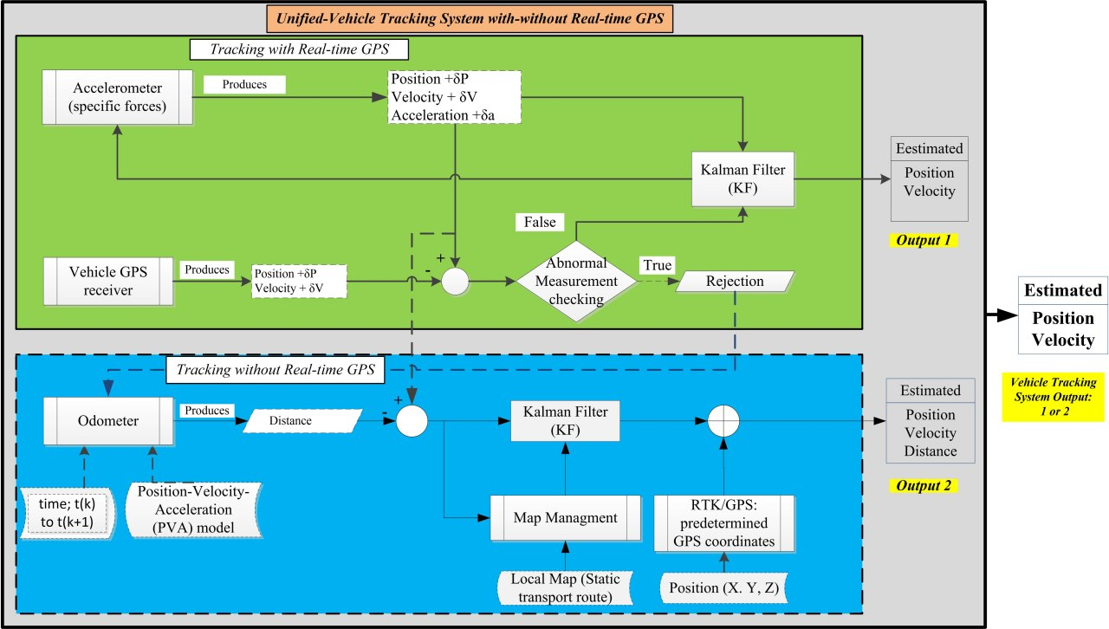
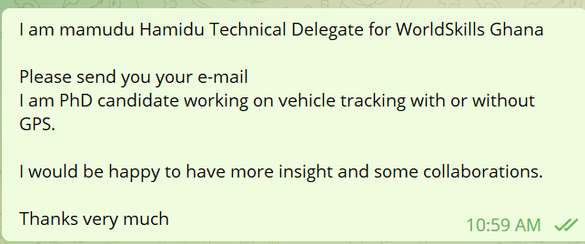


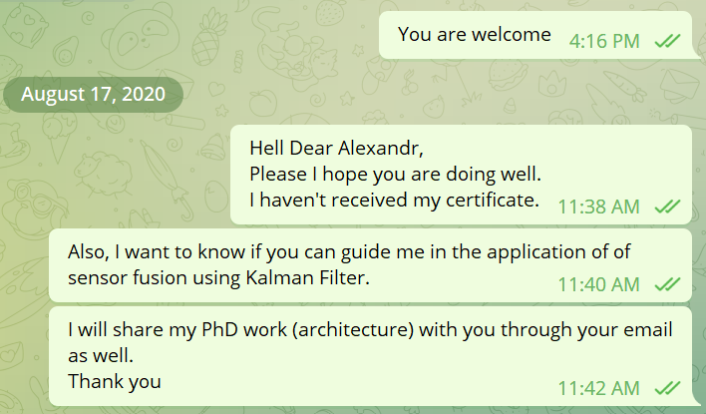
History about Programme and collaboration
in August 7 2020

Slide 10
Your Expectation

Slide 11

Initiative about supporting young people -->

Slide 12
Objective of Programme
Main aim of Programme
Focus
Provide:
Additional Vocational Programme for Reskilling based on WorldSkills standards for the Space Systems Engineering.
Fundamentals of Space Operations in the Development of an Earth Remote Sensing Satellite Project

Slide 13
Modules
Number of modules: 6
Module number | Module Name | Hours
1 | Phenomenon of space systems engineering and it's system dynamics | 3
2 | Spacecraft System composition and Functions | 5
3 | Spacecraft Design and Modeling | 9.5
4 | Electronic Circuitry | 3
5 | Programming | 9.5
6 | Spacecraft manufacturing process and assembling | 6
Total hours |  | 36
Wrap-up |  | 4

Slide 14
Module 1: Phenomenon of space systems engineering and it's system dynamics
# | Topic | time
1 | Nature of Space System Engineering from System Engineering point: | 0.5
2 | Basic laws and formulas. Motion of artificial satellites | 2

Slide 15
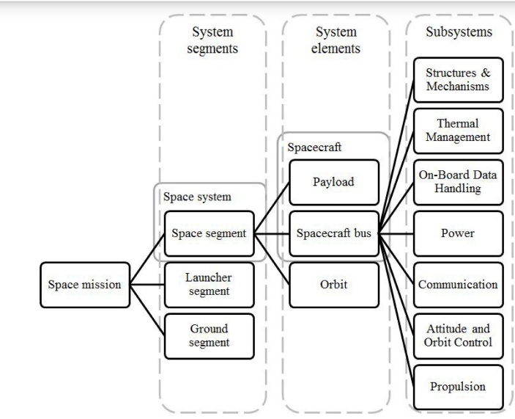
Where are we going?
:)

Slide 16
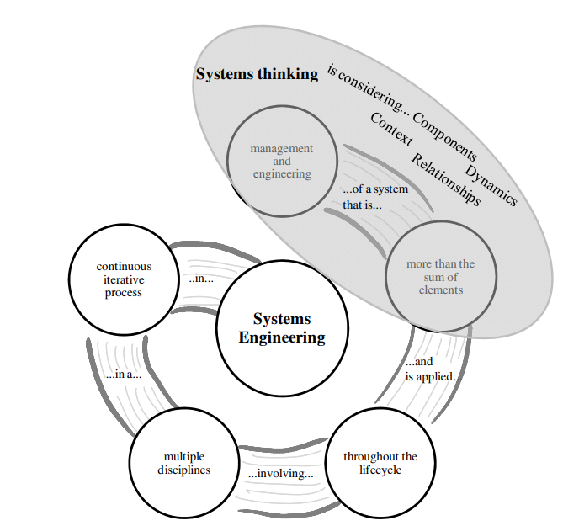

Slide 17
Rationale for Space System

Slide 18
About Space

Slide 19
About Space: Astronomer

Slide 20
About System Elements

Slide 21
System Process

Slide 22
Spacecraft Discipline

Slide 23
Spacecraft Mission

Slide 24
Team Task: Design a system collaboration

Slide 25
Basic laws and formulas. Motion of artificial satellites

Slide 26
Mathematical Model: Reason

Slide 27
Mathematical Model: Coordinates

Slide 28
Mathematical Model: Physical Laws

Slide 29
Mathematical Model: Physical Laws

Slide 30
Kepler’s Laws

Slide 31
Phases of Venus
Shows what Venus looks like through a telescope as the planets go around in their orbits. Compare with the Ptolemaic Phases of Venus simulation.

Slide 32
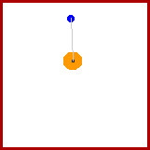
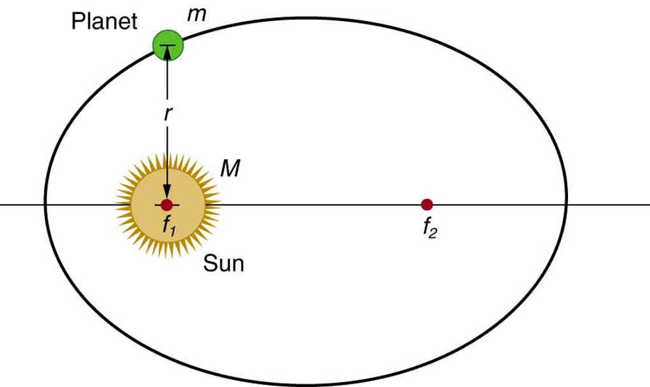
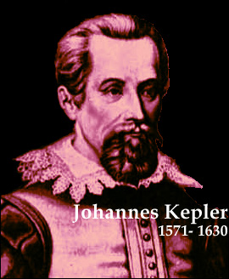
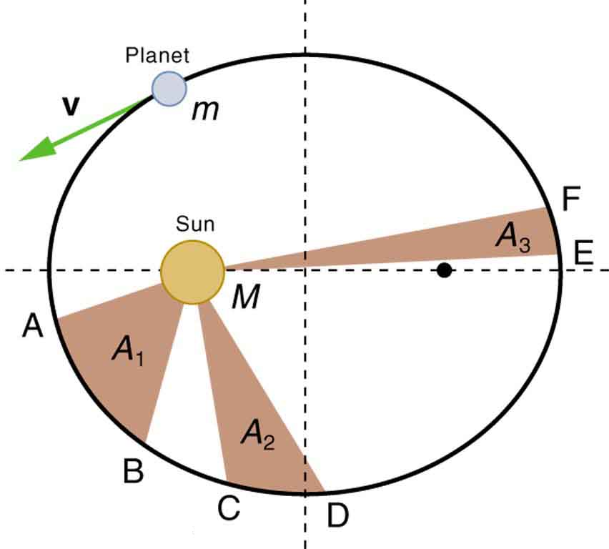
Kepler’s 3 Laws of Planetary Motion
1: The orbit of each planet about the sun is an ellipse with the sun at one focus.
2. Each planet moves so that it sweeps
out equal areas in equal times.
3. The square of the orbital period of any planet is proportional to the cube of the semimajor axis of the elliptical orbit.

Slide 33
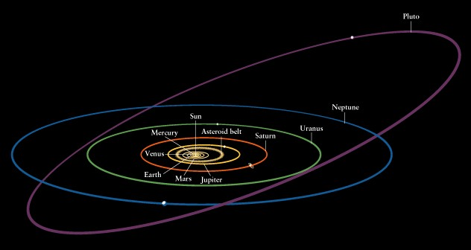
Kepler’s 3 Laws of Planetary Motion

Slide 34
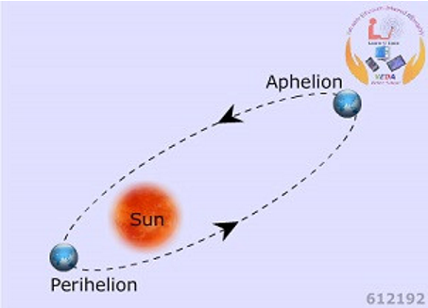
Ellipse dynamics with Earth
When the Earth and other planets revolving around the Sun are furthest from the Sun, the position is called Aphelion.
At Aphelion Earth is about 95 million miles away from the Sun on 4th July and at Perihelion it is about 92 million miles away on 1st January.
When the same bodies are closest to the Sun, the position is called Perihelion.
When the Moon revolving around the Earth is furthest from it, the position is called Apogee and the distance is about 250000 miles. When it is closest to the Earth, the position is called Perigee and the distance is about 220000 miles.

Slide 35
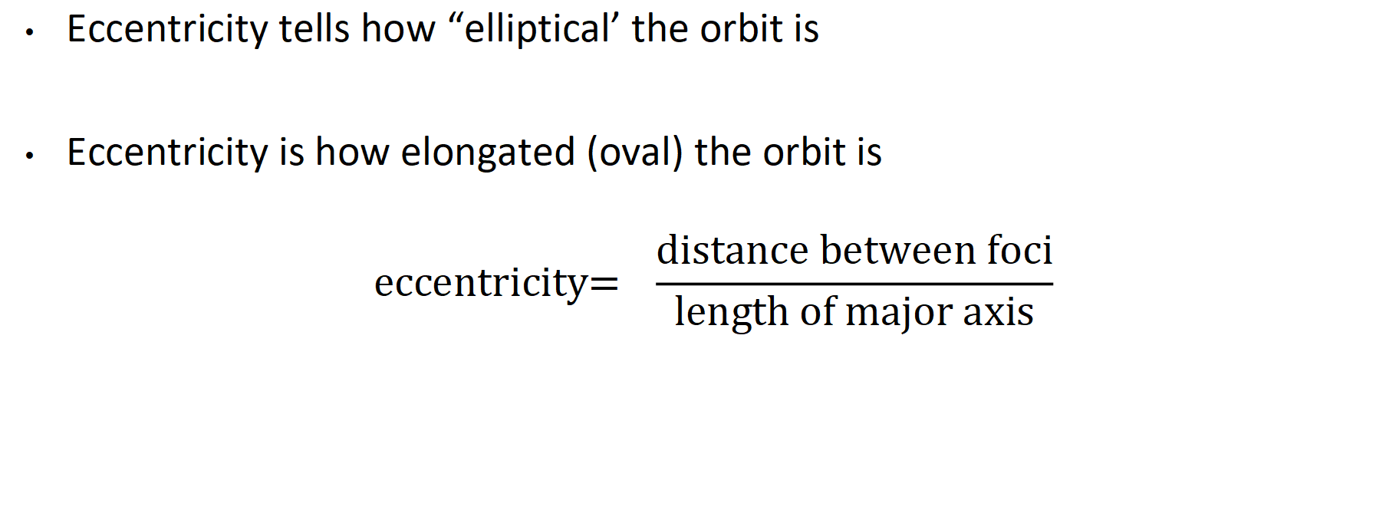
Law 1: All planets orbit in an elliptical fashion
Eccentricity tells how “elliptical’ the orbit is
Eccentricity is how elongated (oval) the orbit is
$$\text{eccentricity}\text{= }\frac{\text{distance} \text{between} \text{foci}}{\text{length} \text{of} \text{major} \text{axis}}$$

Slide 36
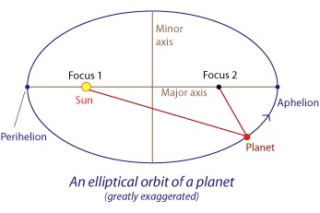
All our planets orbit with the sun at one focus
https://www.youtube.com/watch?v=8wT8nVHg_zo
1st law drawing the orbit

Slide 37
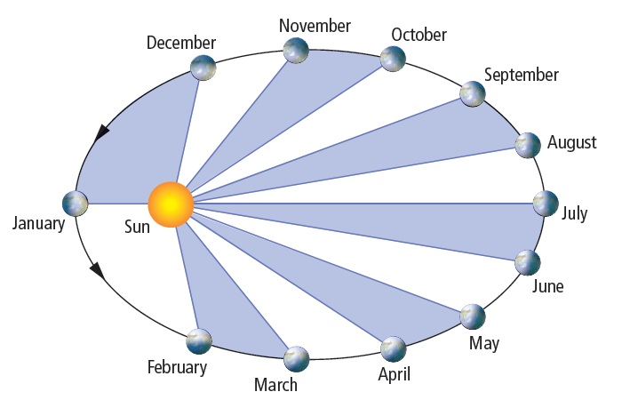
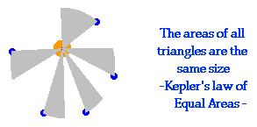
Law 2: Planets sweep out equal areas of their elliptical orbit in equal time periods
http://www.keplersdiscovery.com/AreaTime.html keplers law of equal areas
http://www.youtube.com/watch?v=_3OOK8a4l8Y&NR=1
keppler 2nd law

Slide 38
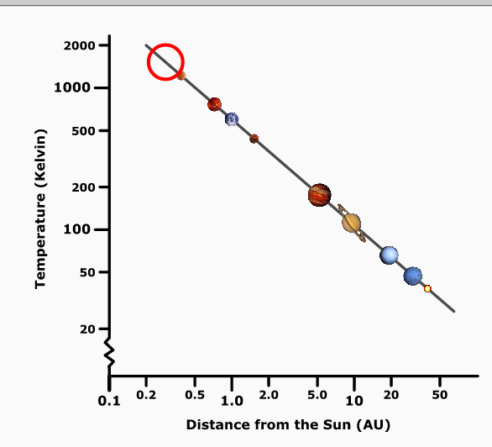
Planet Formation Temperatures Plot
formationtemps.rar
Shows planet formation temperature as a function of distance from the Sun. Also indicates the state (gas or solid) of several substances at the given distance and temperature.

Slide 39
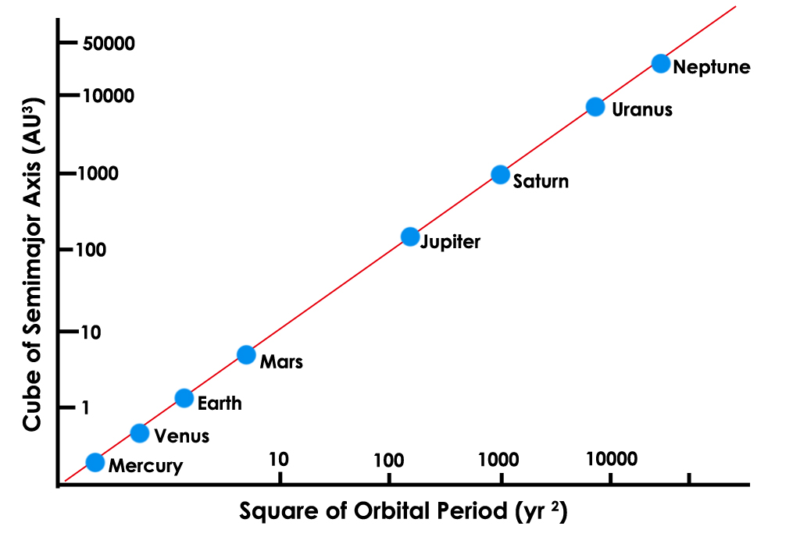
3rd Law: A planet’s period of revolution squared is proportional to its distance from the sun cubed

Slide 40
The 3rd Law: R^{2 (year)} is proportional to d^{3 (distance)}
The closer to the sun, the shorter the year both because the distance is shorter and because the planet moves faster.
Earth 30km/sec,
Mercury 49km/sec,
http://www.youtube.com/watch?v=acrLrlApvy8&feature=related 3rd law

Slide 41
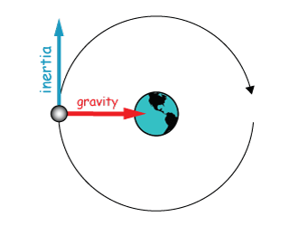
Forces that keep satellites in orbit:
Gravity: http://www.youtube.com/watch?v=MTY1Kje0yLg
Inertia http://www.youtube.com/watch?v=p1_UVSCm-wc

Slide 42
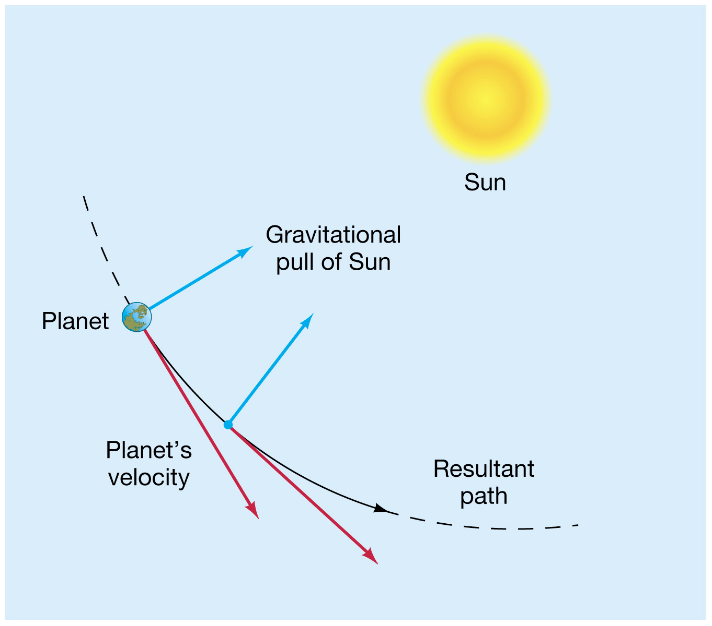
Forces that keep satellites in orbit around their primary:

Slide 43
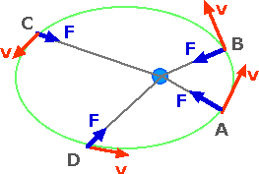
Velocity and Gravitational force change with distance.
The satellite moves faster when closer because the gravitational force is greater.
The satellite’s kinetic energy is greater when velocity is faster.
The sun’s apparent diameter looks larger when the satellite is closer

Slide 44
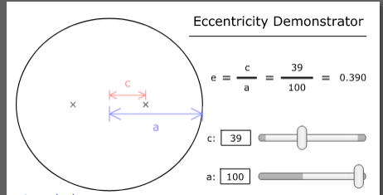
Eccentricity Demonstrator
Demonstrates the parameters that define the eccentricity of an ellipse.
ellipsedemo.rar

Slide 45
Demonstrations
Area | section | section
Basic Motions & Ancient Astronomy | Small-Angle Approximation Demonstrator Heliacal Rising Simulator Big Dipper Clock Shows how stars rotate around the North Star over time (both daily and seasonal motions are shown).)
Coordinates and Motions: | Meridional Altitude Simulator: Shows the geometry for calculating the meridional altitude of objects. Declination Ranges Simulator: Shows how an observer's latitude determines the circumpolar, rise and set, and never rise regions in the sky. Ecliptic Simulator: Shows how the sun's declination and right ascension change over the course of a year. | Azimuth/Altitude Demonstrator: Demonstrates the horizon coordinate system, where altitude and azimuth define an object's position in the sky. (altazimuth)

Slide 46
Newton’s Laws

Slide 47
Universal Law of Gravity
1687
Every particle in the Universe attracts every other particle with a force along a line joining them. The force is directly proportional to the product to their masses and inversely proportional to the square of the distance between them.
M
d
m

Slide 48
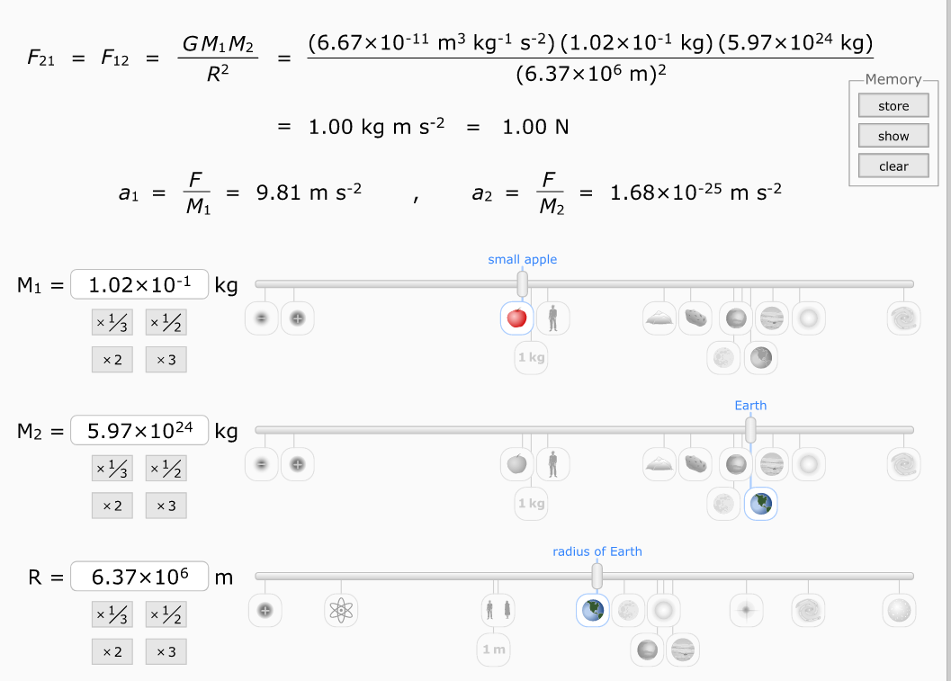
Newton’s Laws Demonstration

Slide 49
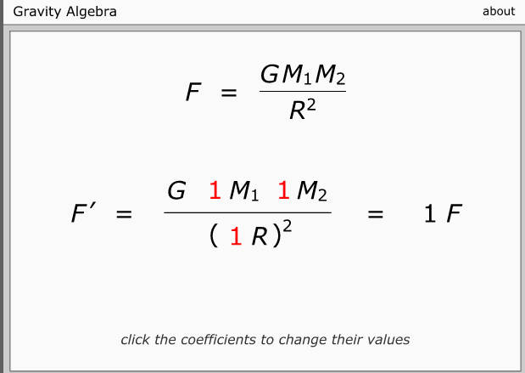
Gravity Algebra
Shows how the force of gravity would be different if the values used in Newton's law of universal gravitation formula are changed.
gravalgebra.rar

Slide 50
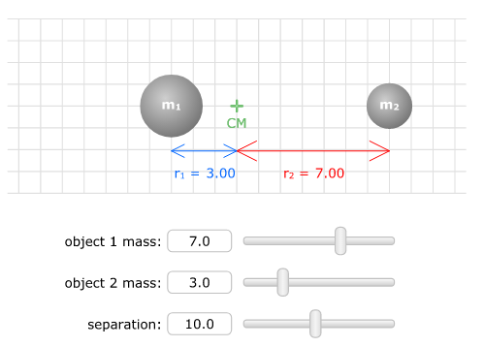
Center of Mass
Center of Mass Simulator
centerofmass.rar
Shows how the center of mass of two objects changes as their masses change.

Slide 51
The Earth
Imagine that the earth is located in the centre of the universe. Also, visualize that around the earth there is a very large sphere that is also centred at the same point.
All the stars are painted on the internal surface of the outside sphere. This outer sphere is known as the celestial sphere.
To specify a position on the surface of the earth we use a system of coordinates that consists of two angles, latitude and longitude.
Latitude is the angle subtended at the centre of the earth between the equator and the parallel of latitude of the observer in the north-south direction.
Longitude is the angle at the centre of the earth subtending an arc at the equator, or the angle at the pole, between the meridian of Greenwich and that of the observer’s meridian.

Slide 52
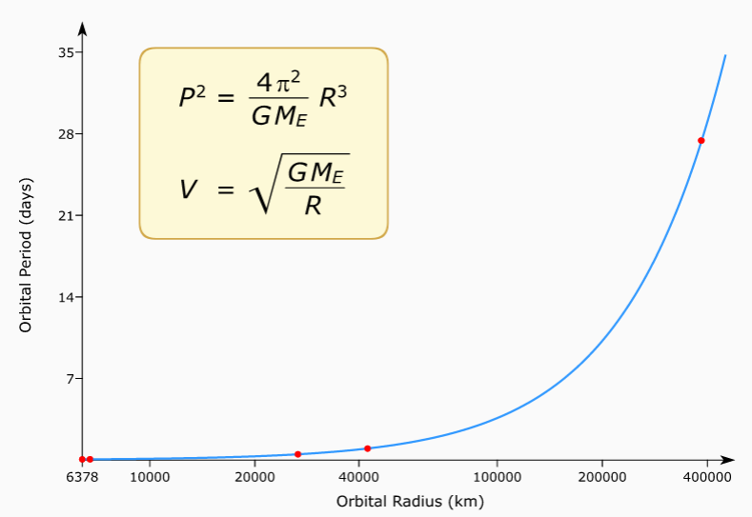
Earth Orbit Plot
Earth Orbit Plot
earthorbitplot.rar
Shows the orbital period as a function of orbital distance for satellites of Earth.

Slide 53
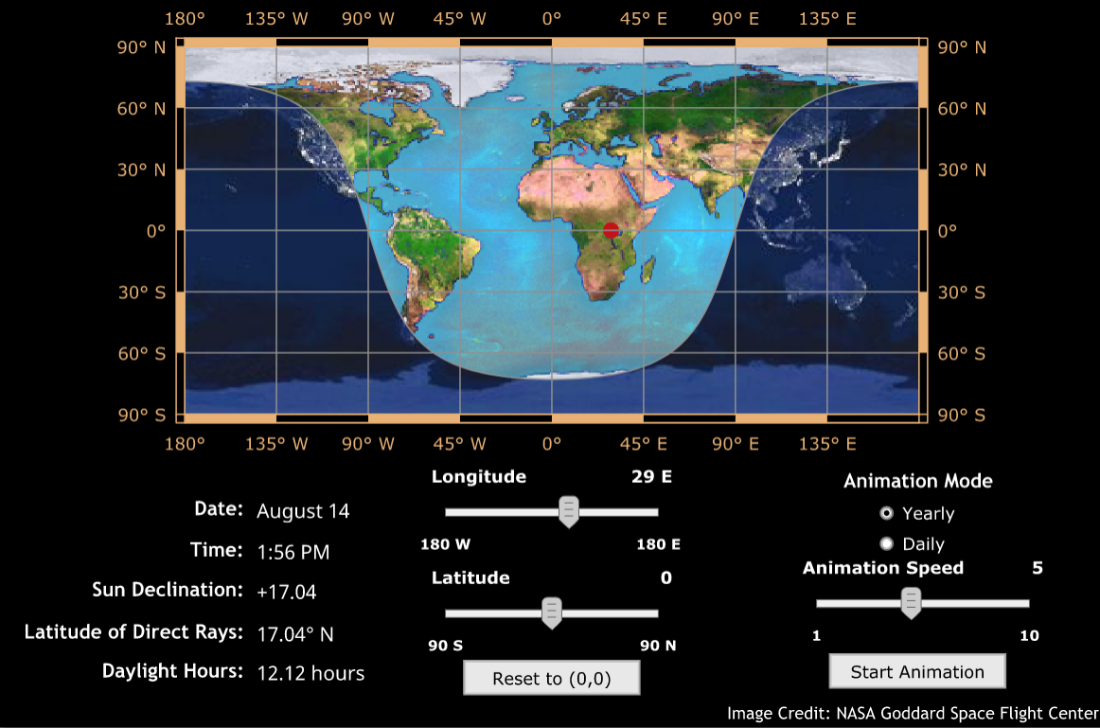
The Earth
Daylight Simulator
daylightsimulator.rar
Simulation showing daylight and nighttime regions on a flat map of Earth. Daily and yearly motions of the sunlight pattern can be shown.

Slide 54
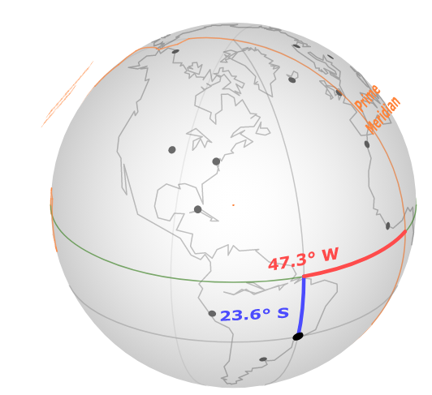
The Earth
Longitude/Latitude Demonstrator
longlat.rar
Demonstrates latitude and longitude with an interactive globe, providing an analogy to the celestial and horizon coordinate systems.

Slide 55
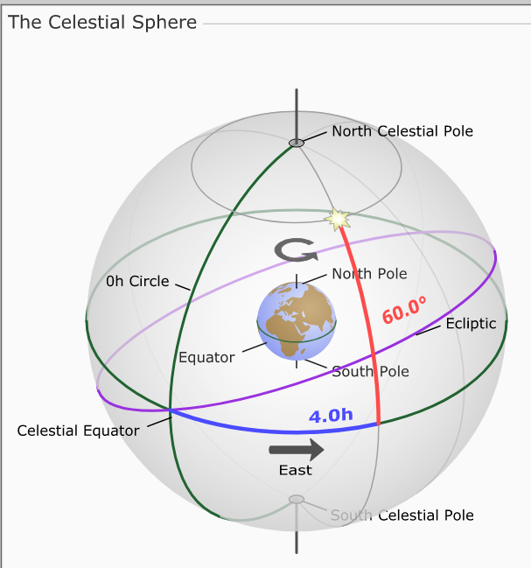
The Earth
Celestial-Equatorial (RA/Dec) Demonstrator
radecdemo.rar
Demonstrates the celestial-equatorial (RA/dec) coordinate system, where declination and right ascension define an object's position on the celestial sphere.

Slide 56
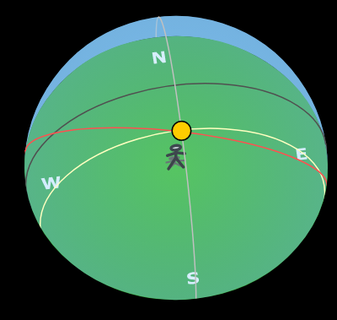
The Earth
Paths of the Sun
sunpaths.rar
Shows how the declination of the sun varies over the course of a year using a horizon diagram.
black: celestial equator
red: ecliptic
yellow: sun’s path on a given day
gray: north-south meridian

Slide 57
Sun Motions
Sun Motions Overview
sunmotionsoverview.rar
Shows the paths of the sun on the celestial sphere.

Slide 58
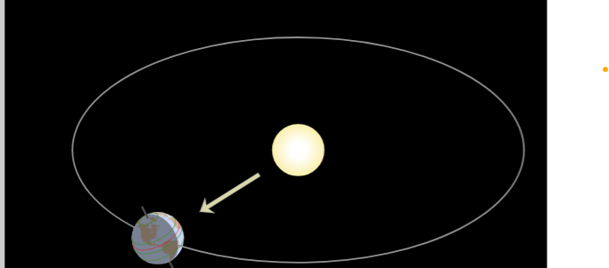
Celestial
Seasons Simulator (NAAP)
eclipticsimulator.rar
Shows the geometry of the earth and sun over the course of a year, demonstrating how seasons occur. This simulator allows both orbital and celestial sphere representations of the seasonal motions.

Slide 59
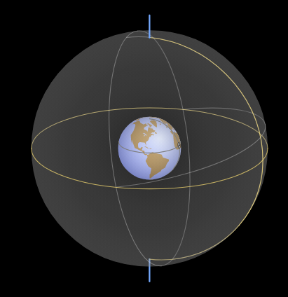
Celestial
Celestial and Horizon
celestialhorizon.rar
Systems Comparison
Demonstrates how the celestial sphere and horizon diagram are related.

Slide 60
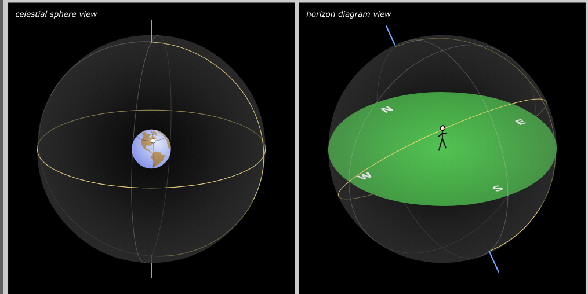
Celestial
Coordinate Systems Comparison
celhorcomp.rar
Shows how the rotation of the earth leads to the apparent rotation of the sky, and how celestial sphere and horizon diagram representations of the sky are correlated.

Slide 61
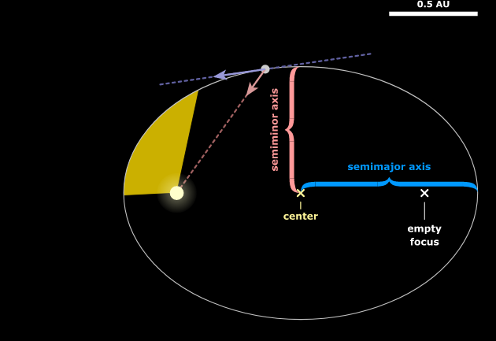
Planetary Orbit
Planetary Orbit Simulator (NAAP)
kepler.rar
Models the motion of a hypothetical planet that orbits the sun according to Kepler's laws of motion. This simulator includes controls for investigating each of Kepler's laws.

Slide 62
Animation supported by
University of Nebraska-Lincoln

Slide 63
Thank you
спасибо
Xie Xie

Slide 64
Mathematical Model: Reason

Slide 65
Earth Orbit Plot
Earth Orbit Plot
earthorbitplot.rar
Shows the orbital period as a function of orbital distance for satellites of Earth.

Slide 66
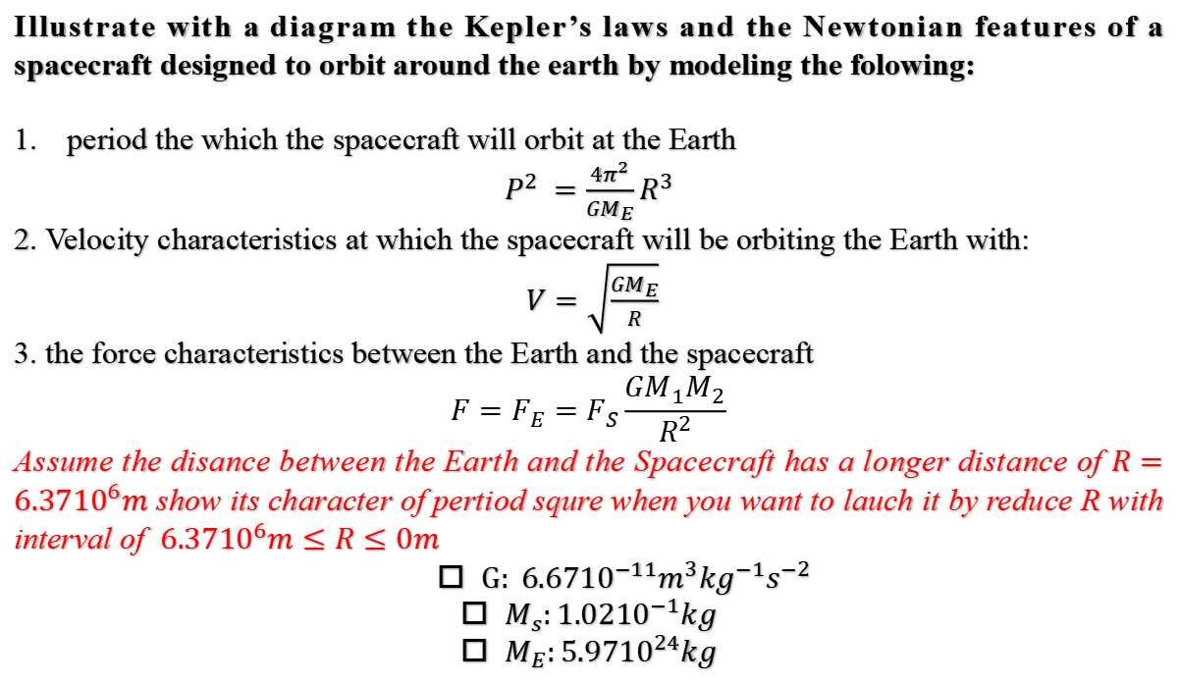
Space Systems Engineering Module1 Assignment
Illustrate with a diagram the Kepler’s laws and the Newtonian features of a spacecraft designed to orbit around the earth by modeling the folowing:
period the which the spacecraft will orbit at the Earth
$P^{2} =\frac{4π^{2}}{GM_{E}}R^{3}$
2. Velocity characteristics at which the spacecraft will be orbiting the Earth with:
$V=\sqrt{\frac{GM_{E}}{R}}$
3. the force characteristics between the Earth and the spacecraft
$$F=F_{E}=F_{S}\frac{GM_{1}M_{2}}{R^{2}}$$
Assume the disance between the Earth and the Spacecraft has a longer distance of $R=6.37{10}^{6}m$ show its character of pertiod squre when you want to lauch it by reduce R with interval of $6.37{10}^{6}m≤R≤0m$
$G: 6.67{10}^{−11}m^{3}{kg}^{−1}s^{−2}$
$M_{s}:1.02{10}^{−1}kg$
$M_{E}:5.97{10}^{24}kg$
By mamudu hamidu; module 1
happy space week !!!

